Slide 1

Linear Regression Project: Predicting Sales from Advertising Spend
MADE BY M. DHANUSH KUMAR

Slide 2
Agenda
Understanding Linear Regression Fundamentals
Dataset Overview and Exploration
Simple Linear Regression Implementation
Multiple Linear Regression Implementation
Model Validation and Diagnostics
Learning Curve Analysis
Practical Applications and Predictions
Implementation Best Practices & Advanced Considerations
Conclusion

Slide 3


Understanding Linear Regression Fundamentals
What is Linear Regression?
The Equation
Key Assumptions
Linearity
A supervised machine learning algorithm modeling the relationship between a dependent variable and one or more independent variables by fitting a straight line.
Independence
Homoscedasticity
Where β₀ is the intercept, β₁...βₙ are coefficients, and ε is the error.
Normality of residuals

Slide 4
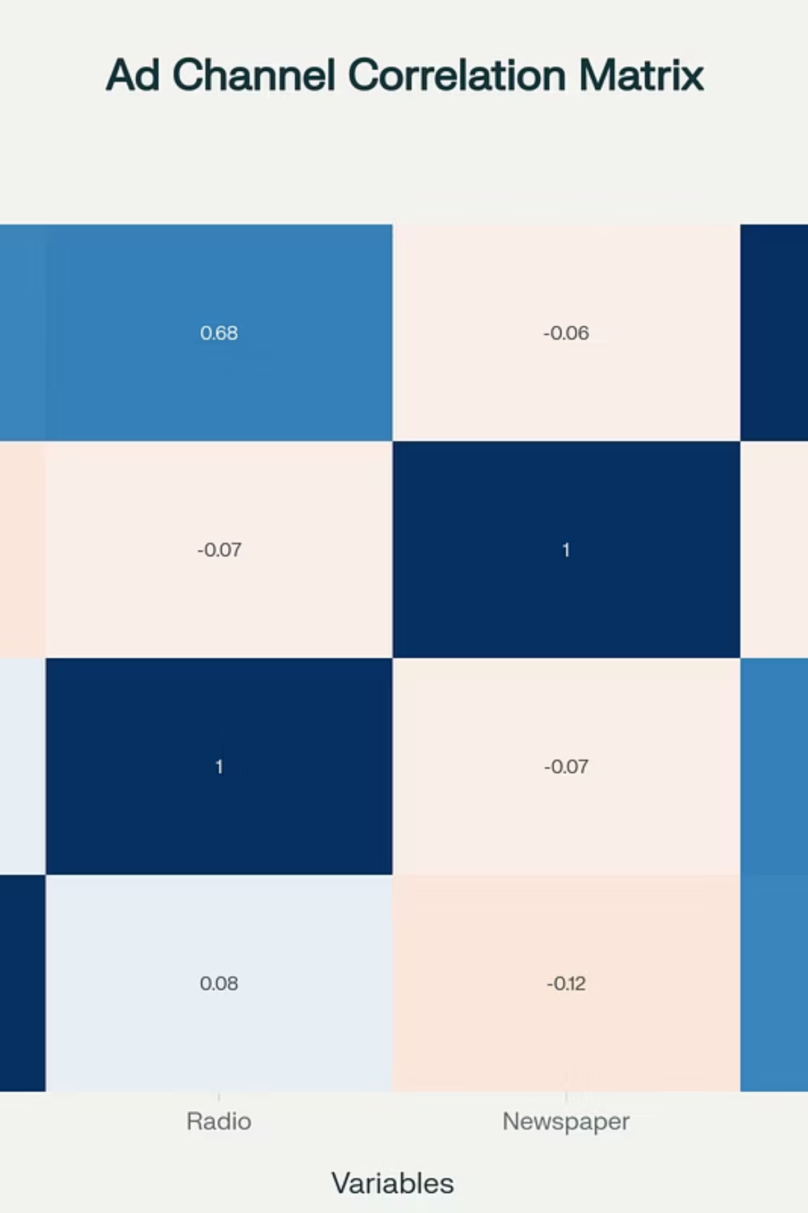
Dataset Overview and Exploration
The project uses an advertising dataset with 200 observations across TV, Radio, and Newspaper advertising budgets (in millions of dollars) and Sales.
Correlation Insights: TV (0.66) and Radio (0.68) show strong positive correlations with sales. Newspaper (-0.06) shows minimal correlation.

Slide 5
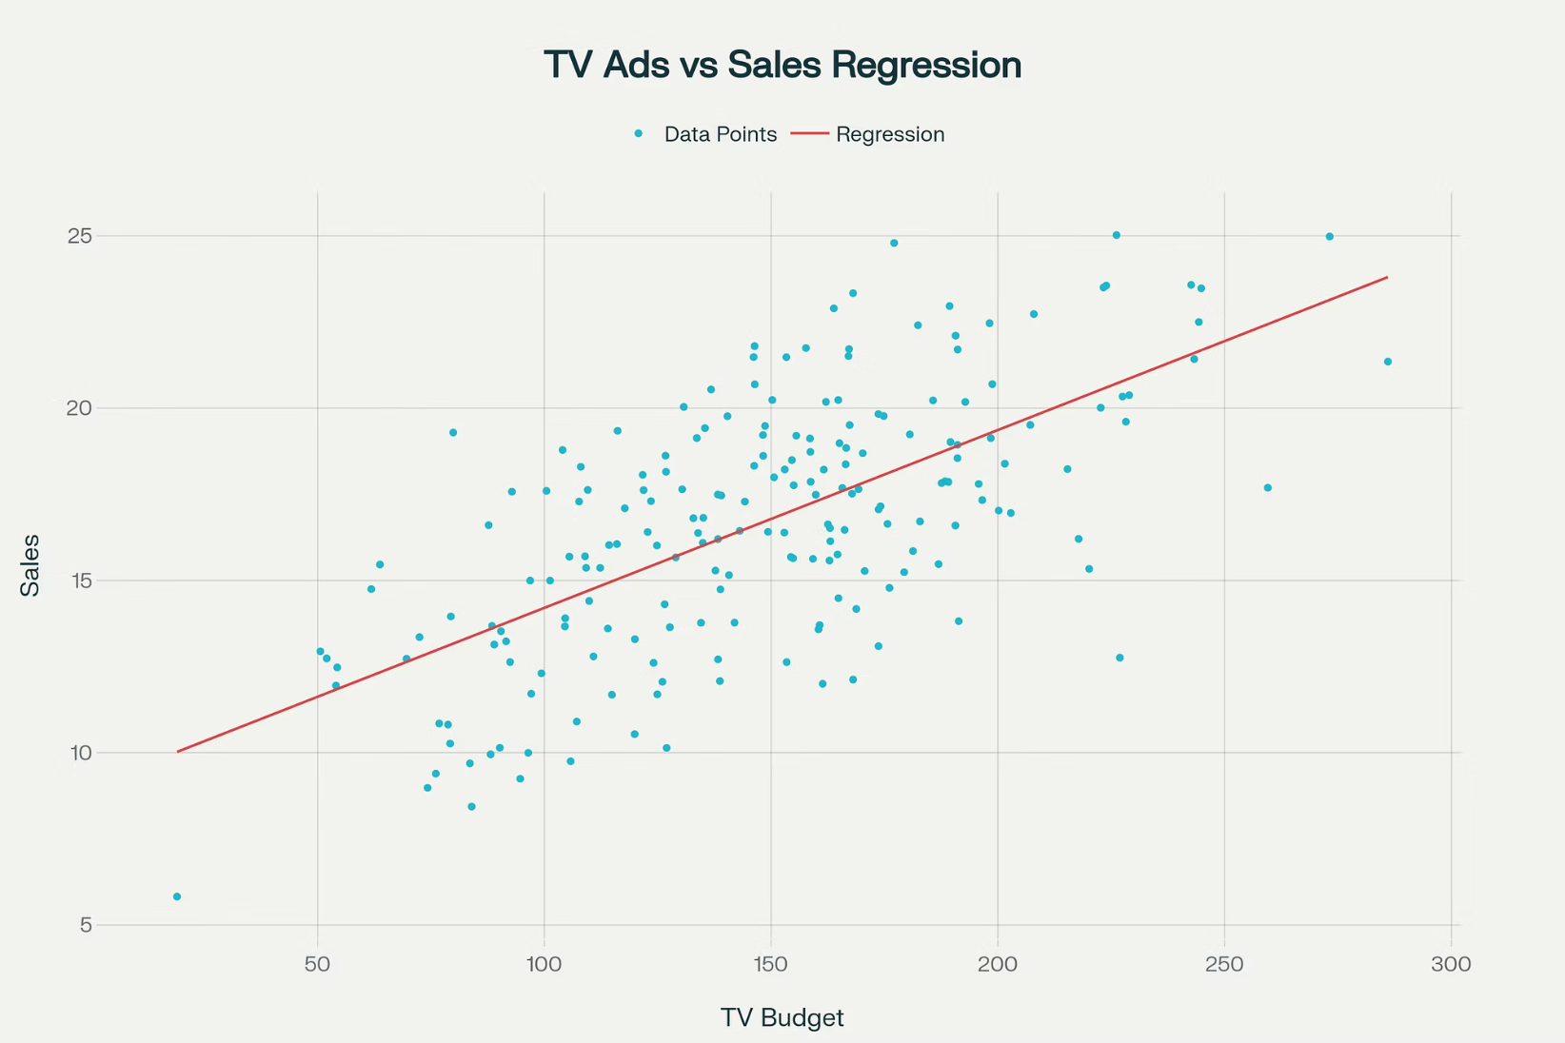
Simple Linear Regression: TV vs. Sales
Model Development
Focuses on TV advertising as the sole predictor for sales. Dataset split 80% training, 20% testing.
Equation: Sales = 8.843 + 0.053 × TV
($1,000 increase in TV ad budget leads to ~$53,000 sales increase).
Performance Evaluation
R-squared (R²): 0.30 (TV explains 30% of sales variance). RMSE: 2.92 ($2,920 average prediction error).

Slide 6
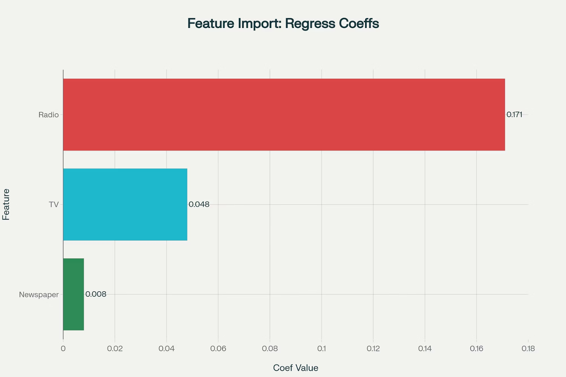
Multiple Linear Regression: All Channels
Enhanced Model Development
Incorporates TV, Radio, and Newspaper advertising as predictors for sales.
Equation: Sales = 4.943 + 0.048×TV + 0.171×Radio + 0.008×Newspaper
Radio has the highest coefficient (0.171), indicating the greatest ROI.
Superior Performance Results
R-squared (R²): 0.85 (85% of sales variance explained, 182% improvement). RMSE: 1.37 ($1,370 average prediction error, 53% improvement).

Slide 7
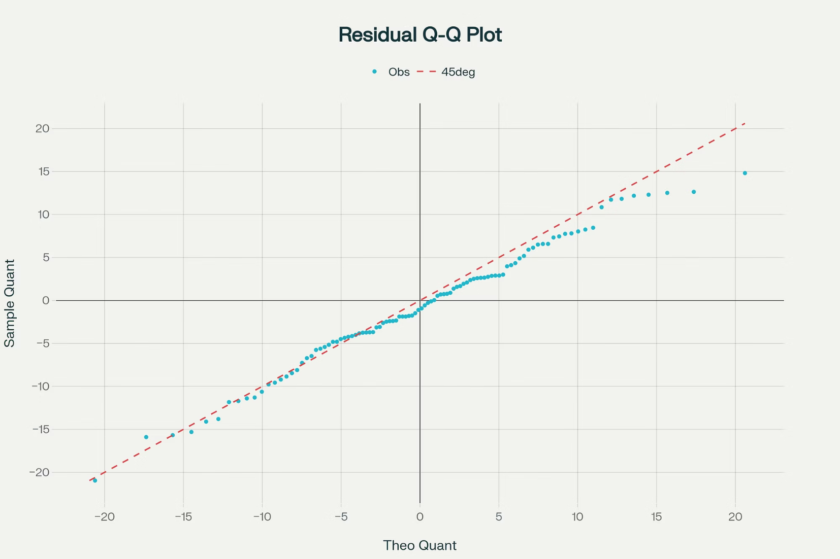
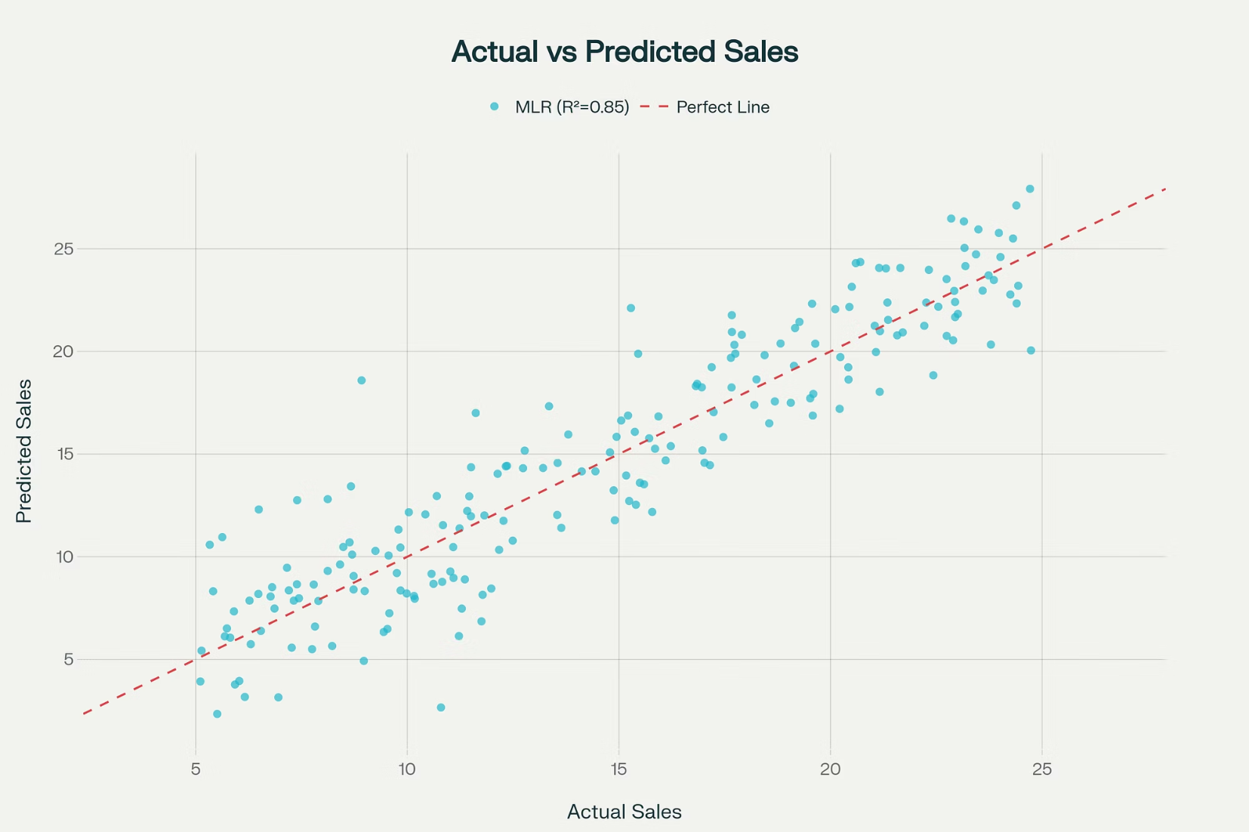
Model Validation and Diagnostics
Residual analysis is crucial for validating model assumptions (linearity, homoscedasticity, normality).
Q-Q plots assess normality; random scatter around zero in residual plots indicates a well-behaved model. Actual vs. predicted plots confirm accuracy.

Slide 8
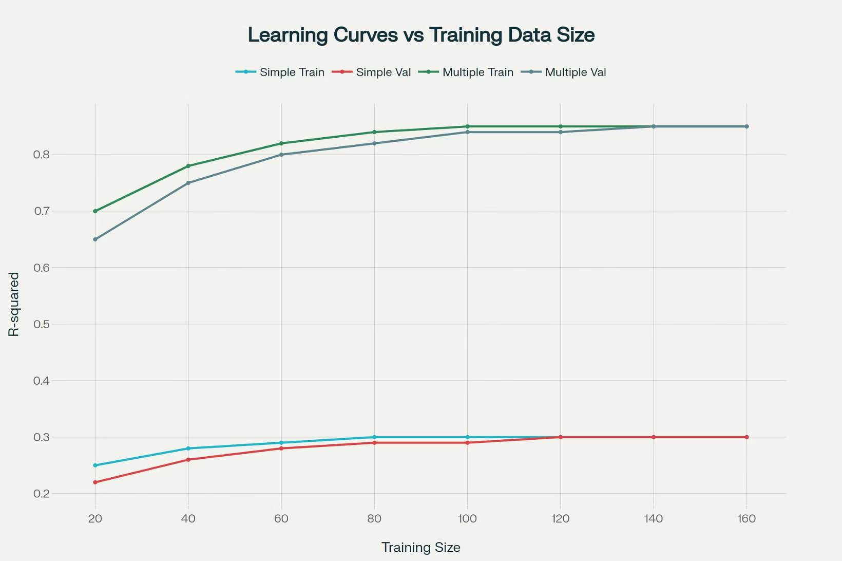
Learning Curve Analysis
Learning curves show how model performance changes with increasing training data.
Simple linear regression plateaus at R² = 0.30, indicating inherent limitations.
Multiple linear regression achieves R² = 0.85 and shows better convergence.

Slide 9
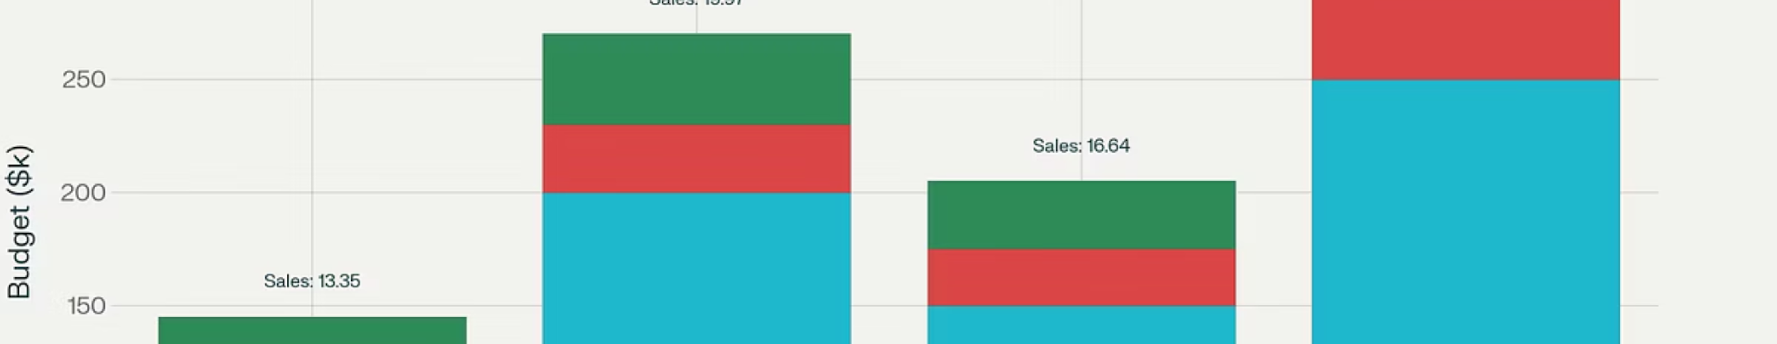
Practical Applications and Predictions
The trained model aids in optimizing advertising budget allocation for businesses.
Strategic Budget Scenarios:
Conservative: $13.35M Sales
Moderate: $16.64M Sales
Aggressive: $19.97M Sales
Premium: $24.16M Sales

Slide 10
Conclusion
The multiple linear regression model, explaining 85% of sales variance, provides a robust foundation for data-driven marketing decisions.
Key Findings
Model Superiority
Strategic Impact
Radio advertising offers the highest ROI, TV is a strong secondary driver, and Newspaper has minimal impact.
Multiple regression significantly outperforms simple regression in accuracy and explanatory power.
Establishes a framework for predictive analytics to optimize ad spend and maximize sales.

